Slide 1
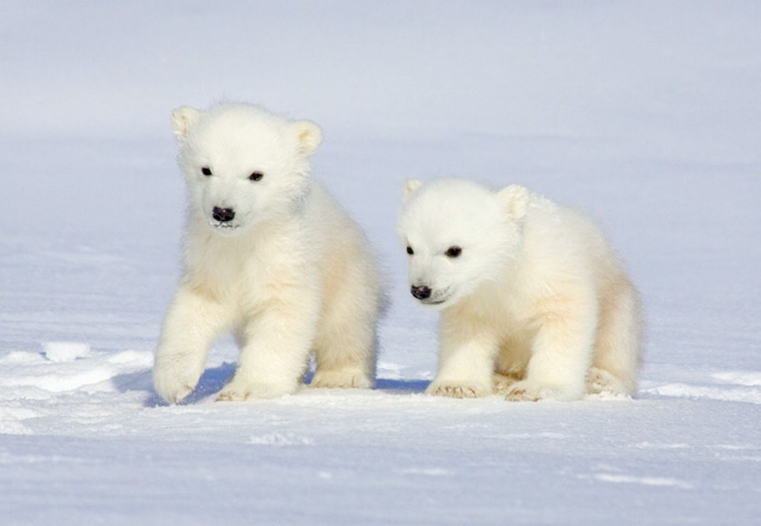
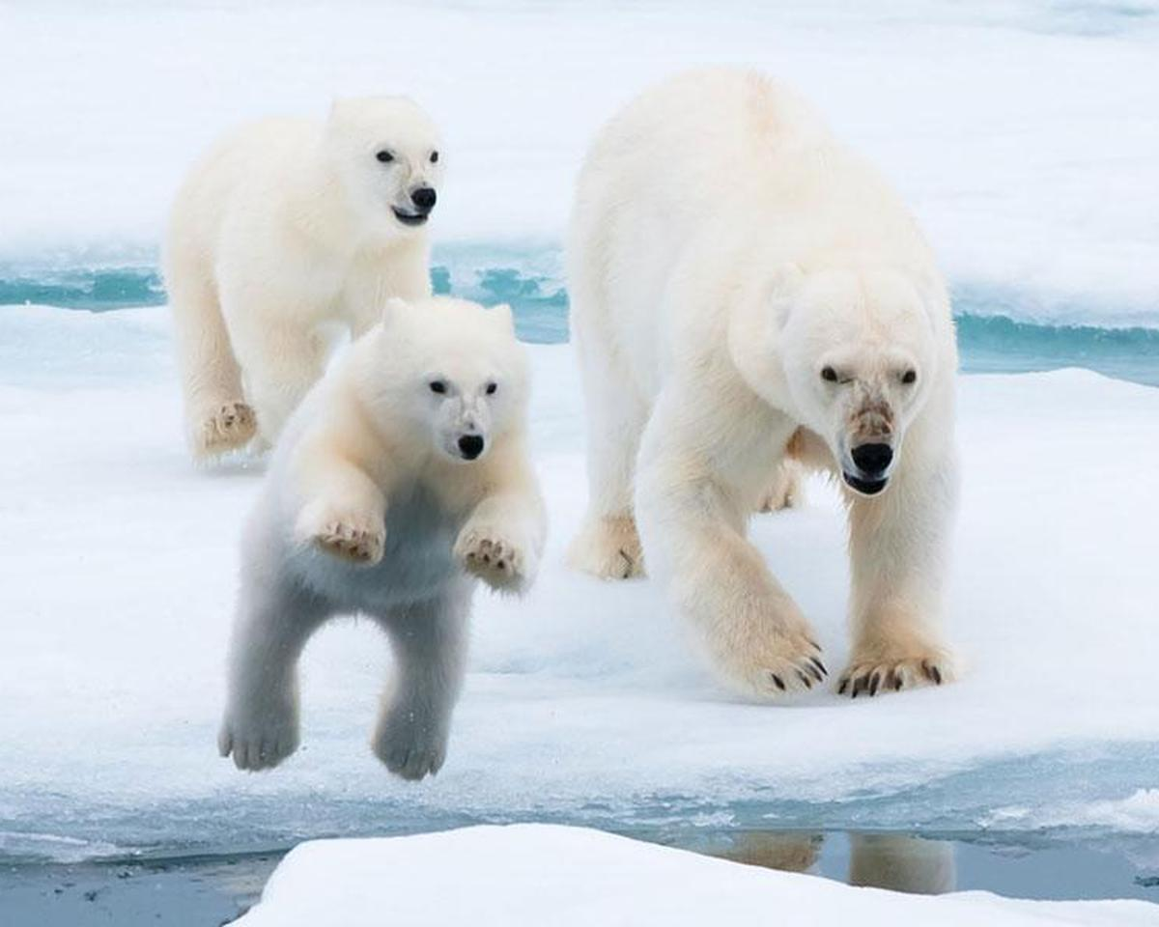
Merry Christmas!
Merry Christmas!
Notes:
To change these cards, replace our sample content with your own. Or, if you’d rather start from a clean slate, press the New Slide button on the Home tab to insert a new page. Now enter your text and pictures in the empty placeholders.

Slide 2
Happy Holidays
Wishing you and yours a great holiday and New Year!
The Christmas Family
Happy Holidays
Wishing you and yours a great holiday and New Year!
The Christmas Family
Notes:
To change these cards, replace our sample content with your own. Or, if you’d rather start from a clean slate, press the New Slide button on the Home tab to insert a new page. Now enter your text and pictures in the empty placeholders.

