Slide 1


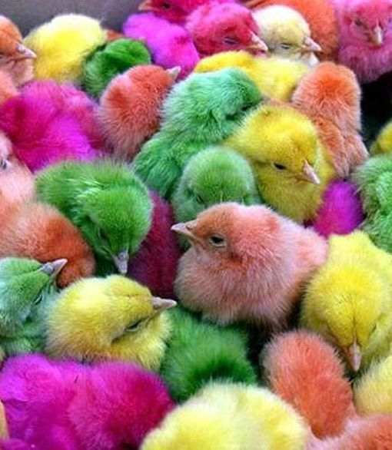
Picture Quick Styles give you great looking “frames” in a single click.

Slide 2


Slide 3


Slide 4


Slide 5


Slide 6


Slide 7


Slide 8


Slide 9


Slide 10
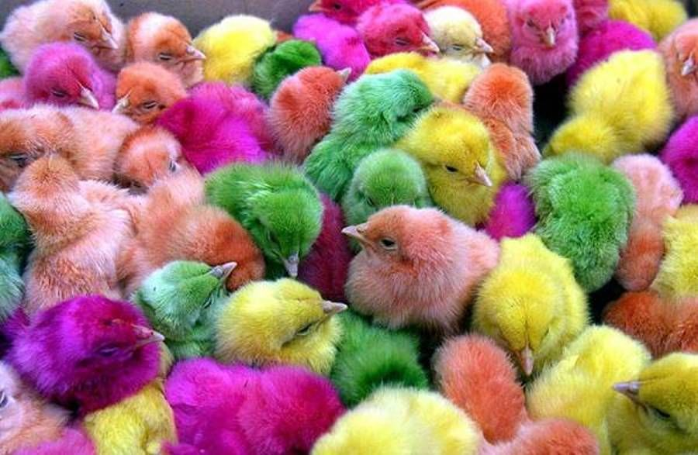

Slide 11


Slide 12


Slide 13
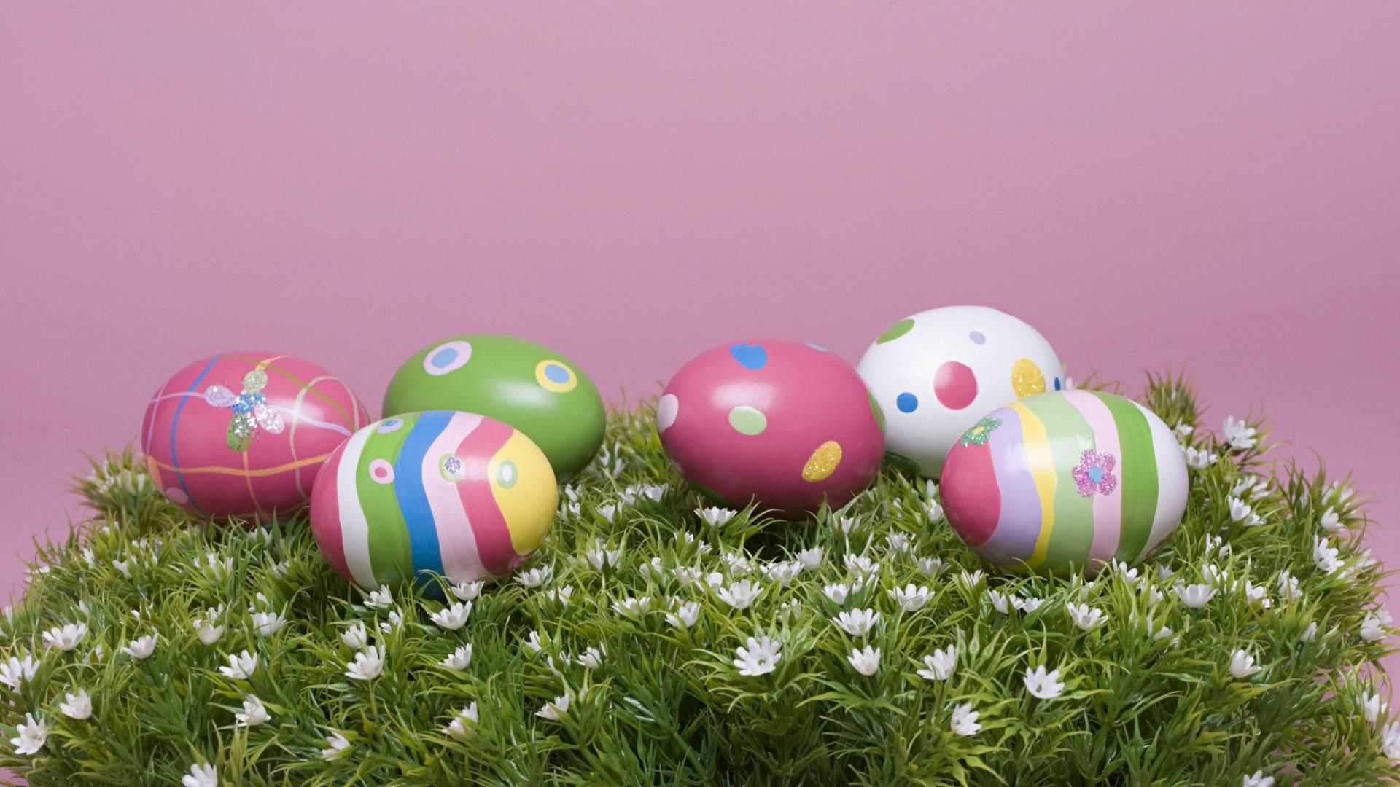

Slide 14


Slide 15


